Slide 1

Hospital Data Analysis
Group no 1
Prathamesh Patil
Rushikesh Lakhpati
Ronit Tiwari
Ashwini Patil
Srikanth Chintada
Shweta Dhumal
Shobith Joseph

Slide 2
CMS Information
CMS is founded in 1977 , headquarter located at Baltimore, MD
CMS is a government Administration Industry
The Centers for Medicare & Medicaid Services (CMS), a federal agency within the U.S. Department of Health and Human Services, is one of the largest purchasers of health care in the world
Medicare, Medicaid, and the Children's Health Insurance Program (CHIP) provide health care for one in four Americans.
CMS is the federal agency that provides health coverage to more than 160 million through Medicare, Medicaid, the Children's Health Insurance Program, and the Health Insurance Marketplace. CMS works in partnership with the entire health care community to improve quality, equity and outcomes in the health care system

Slide 3
Hospital Data analysis KPI’s
Geographic Overview:
Hospitals detailed by State, County, and City.
Hospital Landscape:
Total hospitals categorized by types and ownership.
Emergency Services Presence:
Hospitals providing emergency services.
Overall Rating Analysis:
In-depth examination of overall hospital ratings.
Measure Group Insights:
Ratings breakdown for mortality, safety, readmission, patient experience, timely, and effective care.
Service Years Evaluation:
Assessment of hospitals based on their years of service.
Performance Benchmark:
Comparison of hospitals' performance against measure names, with ratings compared to national standards.
Patient Engagement:
Tracking patient visits and returns based on measure names.
Average Scores Overview:
Averages scores summarized by State, County, and City across various measures.

Slide 4
Problem Statement
The Overall Hospital Quality Star Rating system faces challenges related to data reporting, exclusion of Department of Defense hospitals, and potential bias in weight redistribution and clustering algorithms.
Issues such as variable data collection periods, periodic updates, and a high percentage of hospitals categorized as "N/A" also impact accuracy. Stakeholder engagement and public understanding are crucial for the system's effectiveness.
Addressing these challenges through regular reviews and transparent practices is essential for maintaining credibility.

Slide 5





Data Challenges / Transformation
Converting
Converting raw data into interactive dashboards by gaining useful insights about , Country, State, City, etc.
Observing
Observing the data, cleaning the data into power query for excel and Power BI, creating single relationships workbooks and if needed creating additional columns.
Applying
Applying DAX formulas combining data from various sources in power BI. Creating measures for Power BI and also created parameter and calculated filed for Tableau Creating relationships in tableau, calculated field for various formulas for creating kpi’s and dashboard.
Designing, editing and formatting
Designing, editing and formatting the dashboard in Excel, Power BI and tableau enabling dynamic data visualization. Filters, slicers, formatting techniques, Actions etc
Extracting
Extracting excel CSV file into MySQL databases and executing queries based on the given kpi’s using joins for multiple table columns.

Slide 6
Suggestion
Visualization: Add bar/pie charts for star rating distribution.
Interactivity: Enable detailed info on hospitals/groups.
Navigation: Implement user-friendly filtering.
Terminology: Provide tooltips for better understanding.
Comparisons: Include benchmarks for measure groups.
Mobile Optimization: Adapt layout for broader device accessibility.
Highlight Trends: Add a summary section for key findings.
Data Drill-Down: Allow detailed insights into measures/groups.
Time Trend Analysis: Show the evolution of star ratings over time.
Payment: Provide cost-effective analytics solutions
Blank data: Improve data quality and integrity & Strengthen data privacy and security measures.

Slide 7

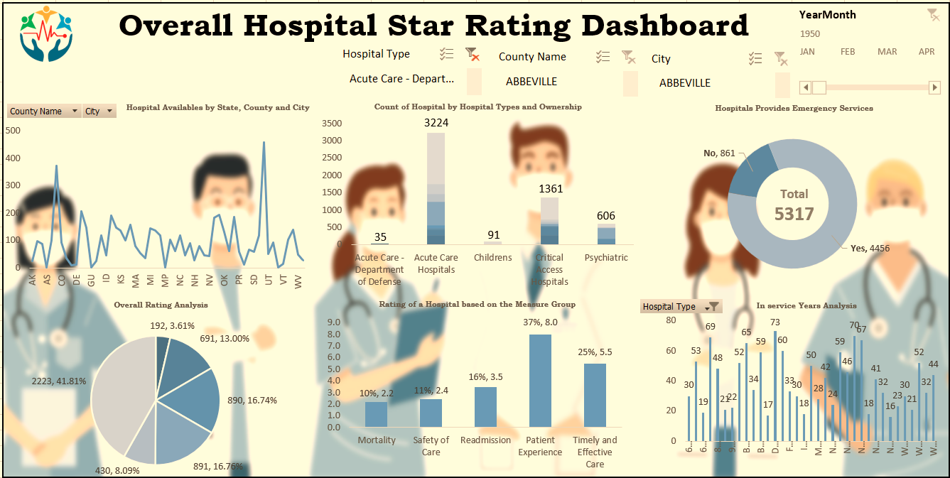
Excel Dashboard

Slide 8
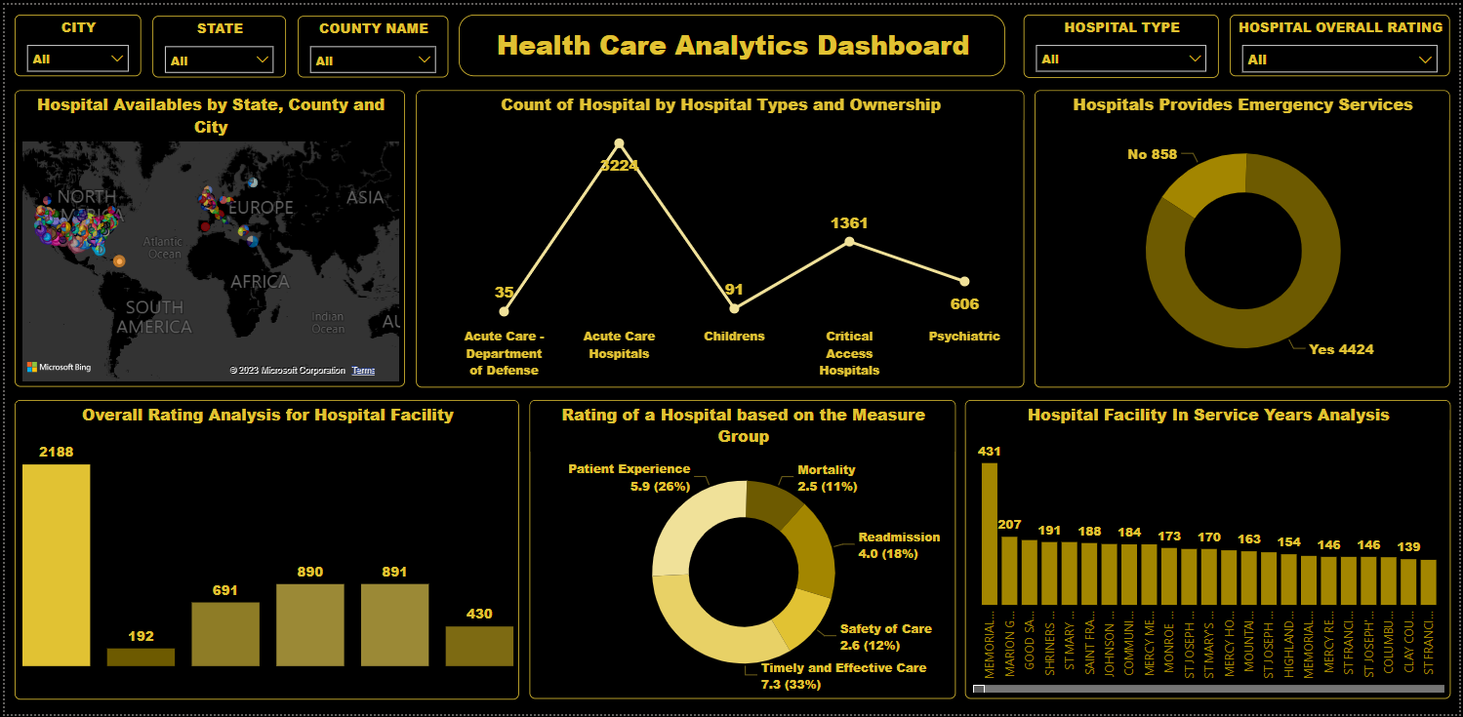
Power BI Dashboard

Slide 9
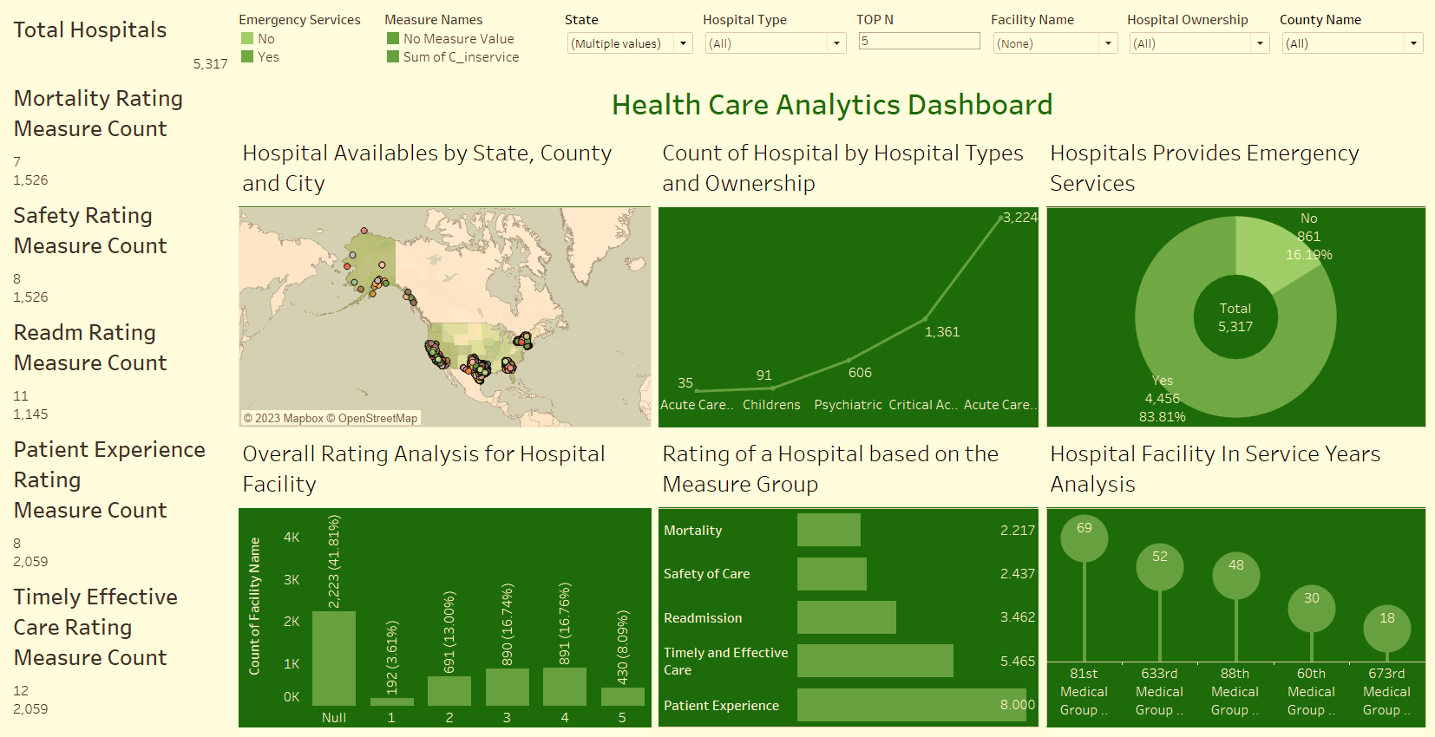
Tableau Dashboard

Slide 10
Thank You

